Slide 1
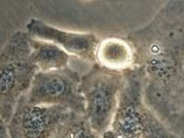
Identifying Hidden Free Energy Barriers
Chris Neale, Angel García, Régis Pomès
Rensselaer Polytechnic Institute
x34,000
Creative Commons (Asd.and.Rizzo)
M.W. Brightman , T.S. Reese,
J. Cell. Biol. 1969. 40(3):648-77
Vertex Pharmaceuticals, Boston
2014 Workshop on Free Energy Methods in Drug Design
Creative Commons (Mariana Ruiz)

Slide 2
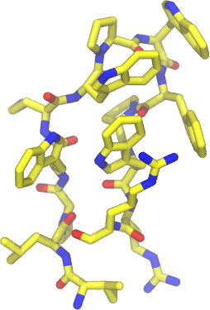
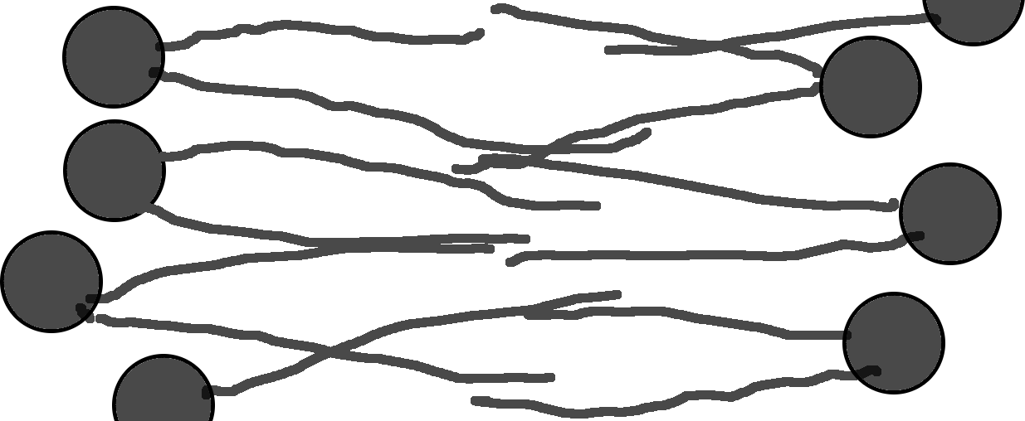
Umbrella sampling
Order parameter
G.M. Torrie, J.P. Valleau, J. Comput. Phys., 1977, 23(2):187-199

Slide 3
1. Problems
Outline
Sampling convergence
Force field accuracy
2. Progress
Systematic sampling errors

Slide 4
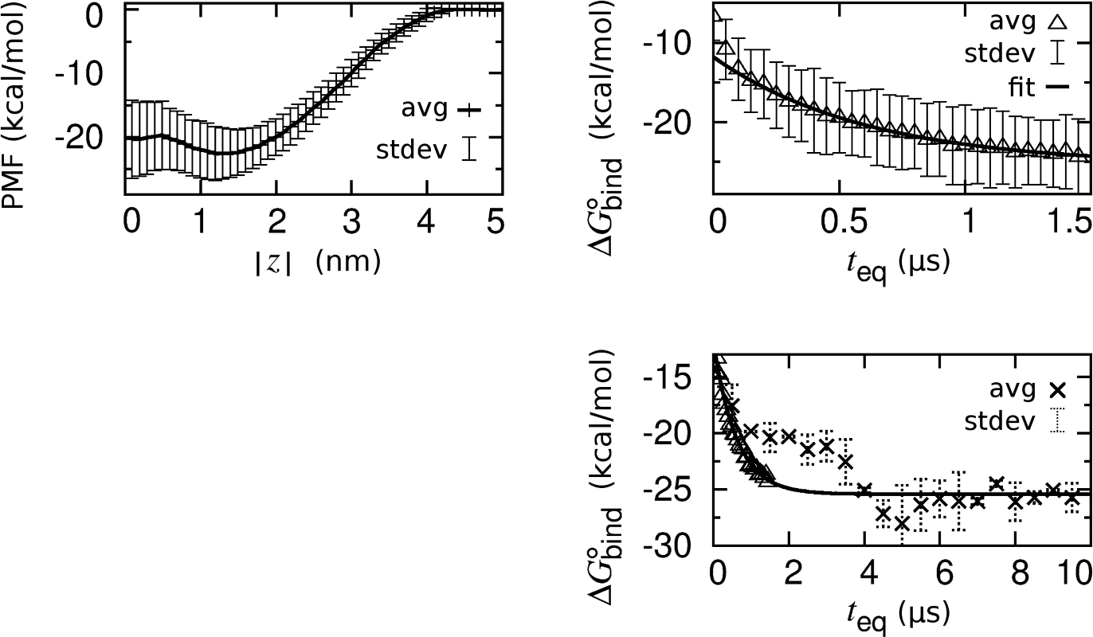
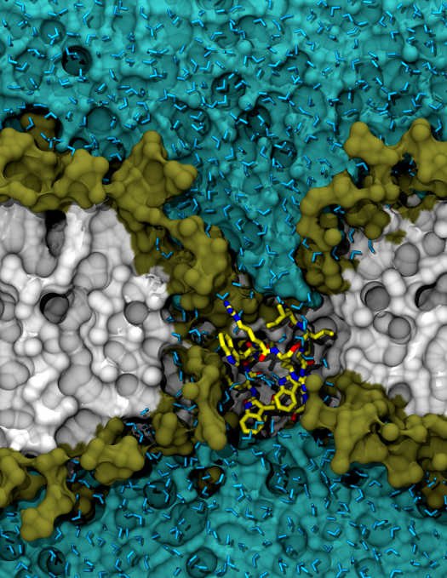
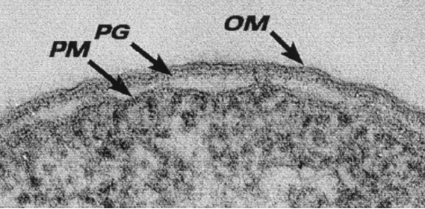
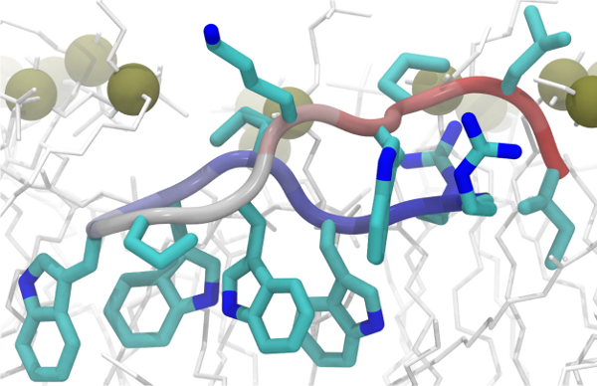
Indolicidin-bilayer binding
100nm
T. Beveridge, J. Bacteriol., 1999, 181(16):4725-4733
C. Neale, J.C.Y. Hsu, C.M. Yip, R. Pomès, Biophys. J., 2014, 106(8):L29-L31

Slide 5
Why do these simulations take so long to converge?
Peptide conformational change
Bilayer reorganization

Slide 6
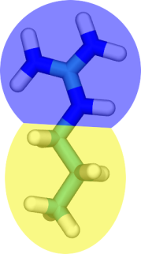
Bilayer reorganization
arginine
C. Neale, W.F.D. Bennett, D.P. Tieleman, R. Pomès, J. Chem. Theory Comput., 2011, 7(12):4175-4188.

Slide 7
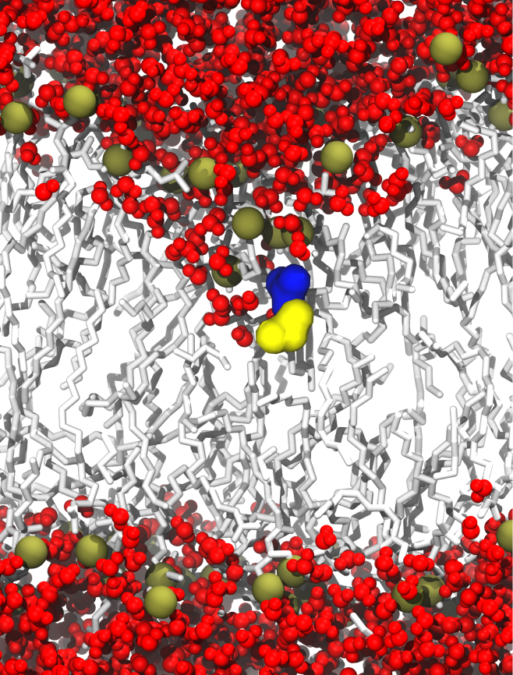
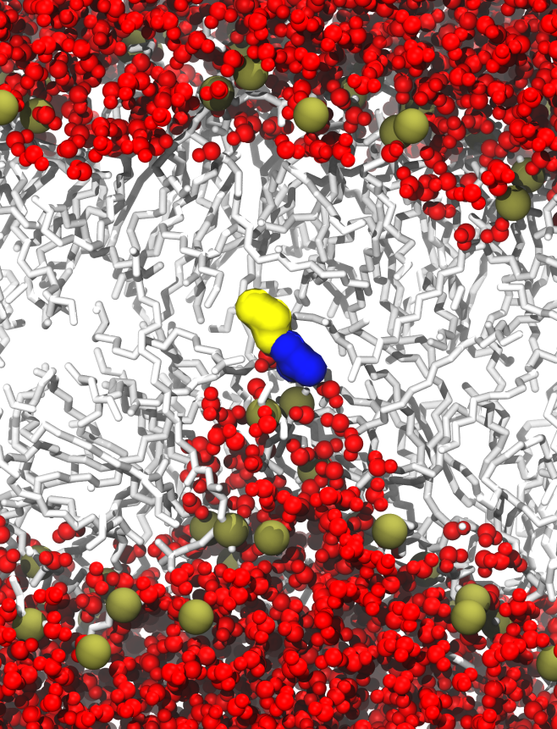
Immersion depth autocorrelation
arginine
Bilayer
center
water

Slide 8
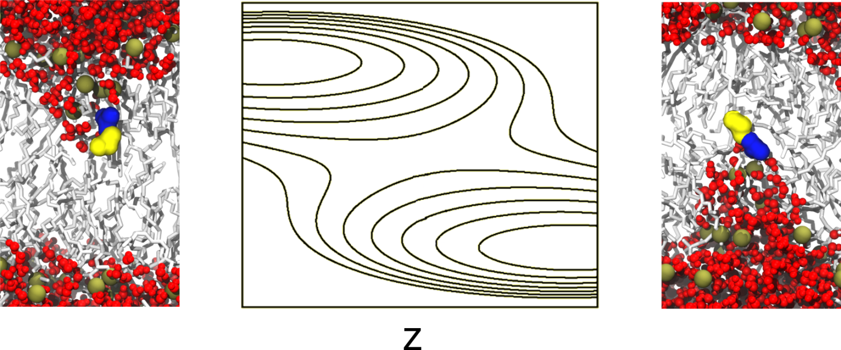
Hidden free energy barriers
Free energy contour map
a
b
a
b

Slide 9
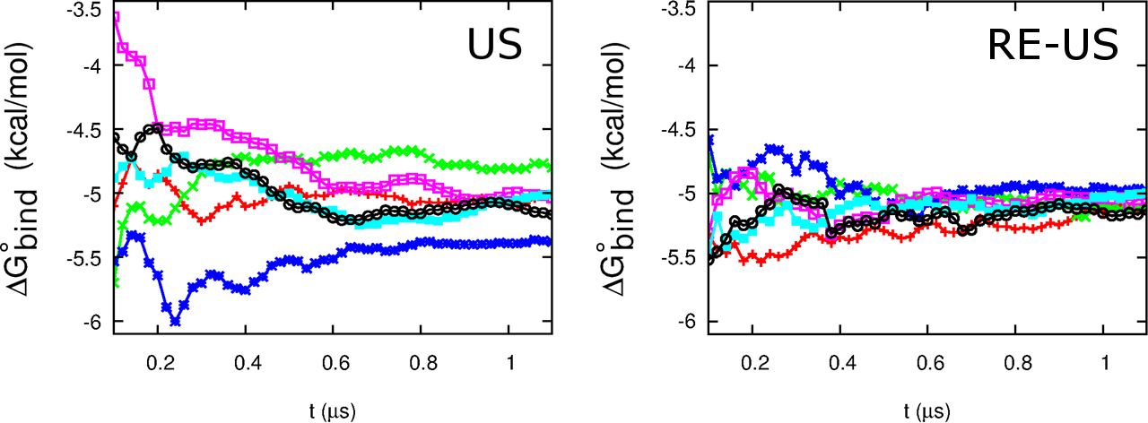
Replica exchange enhances convergence
arginine
C. Neale, C. Madill, S. Rauscher, R. Pomès, J. Chem. Theory Comput., 2013, 9(8):3686-3703.

Slide 10
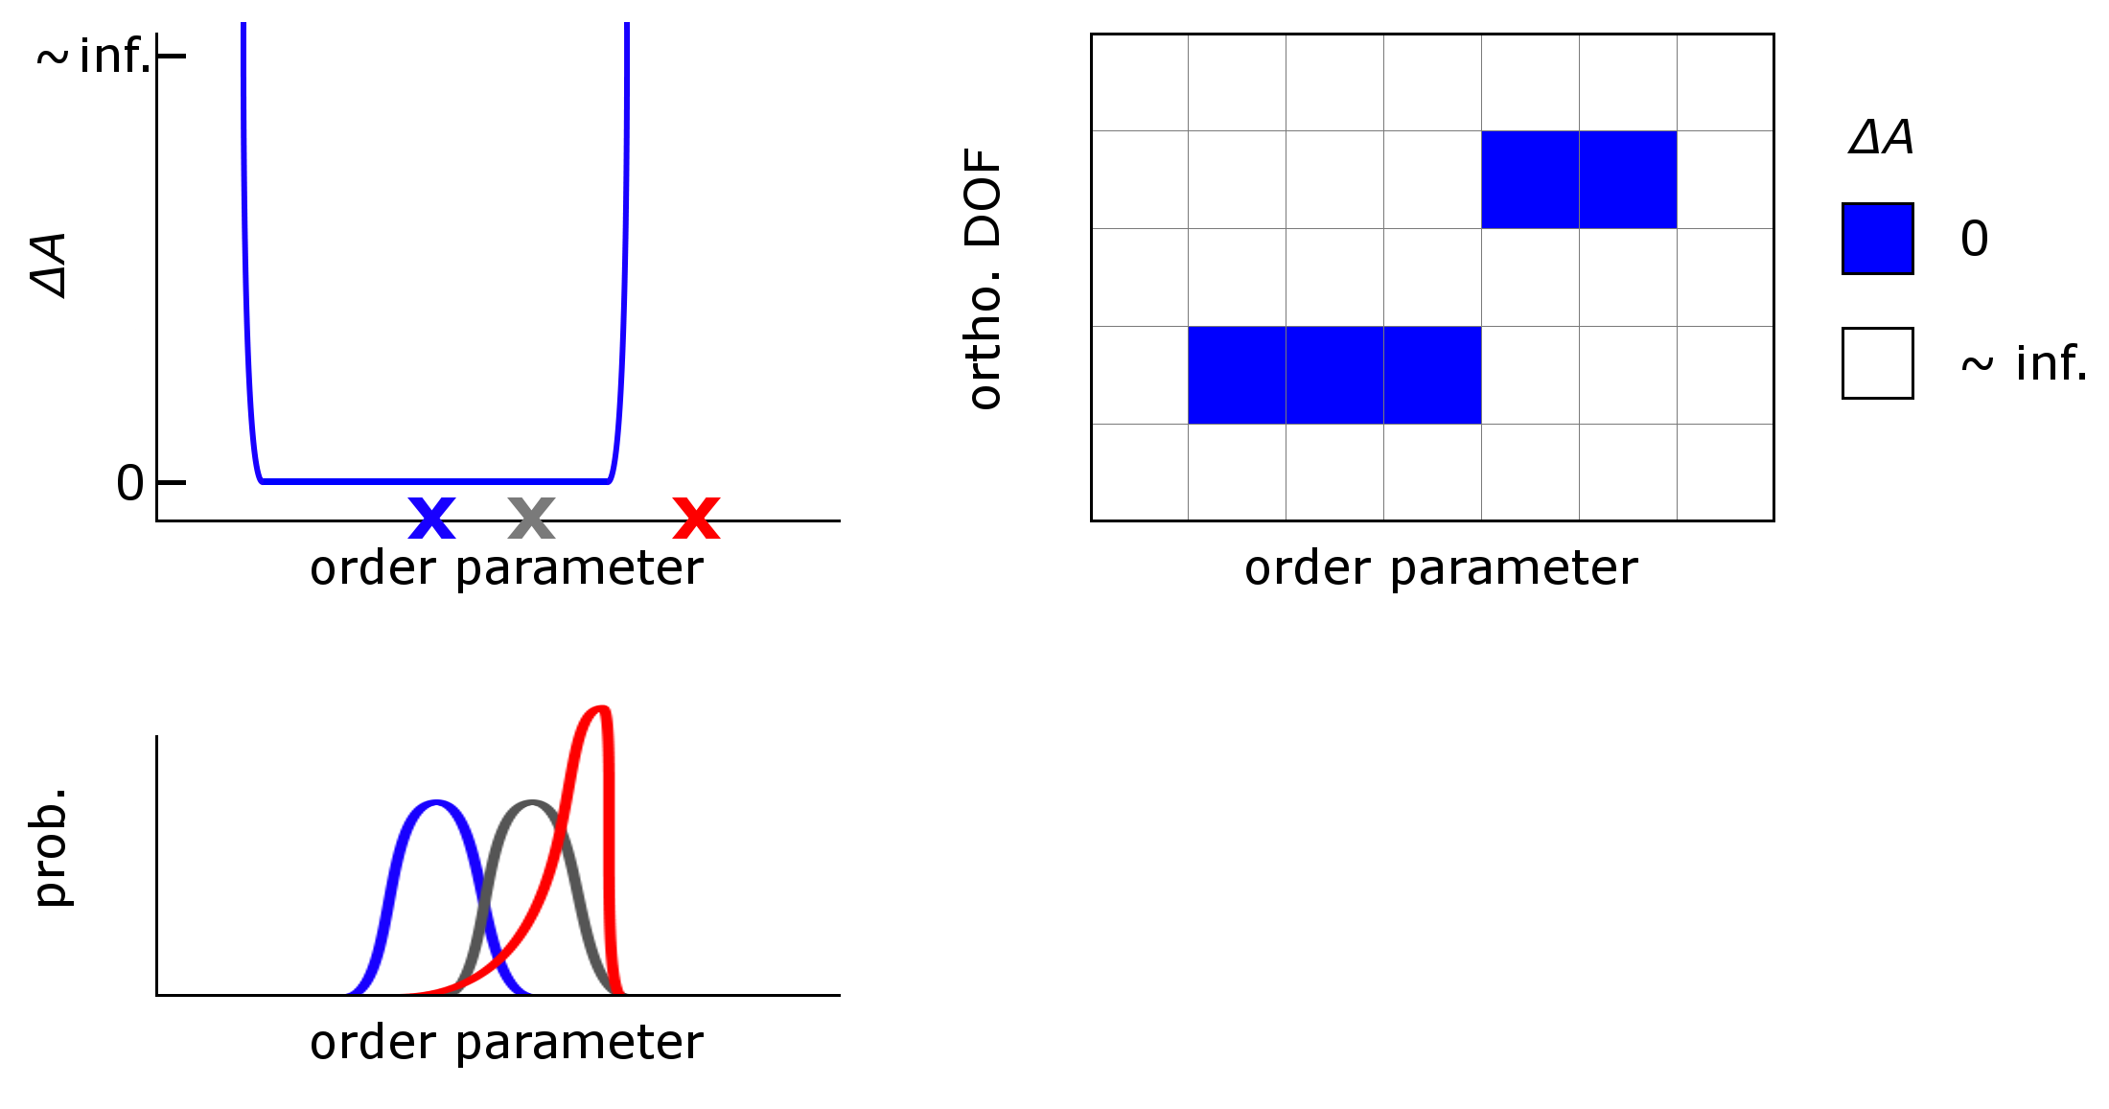
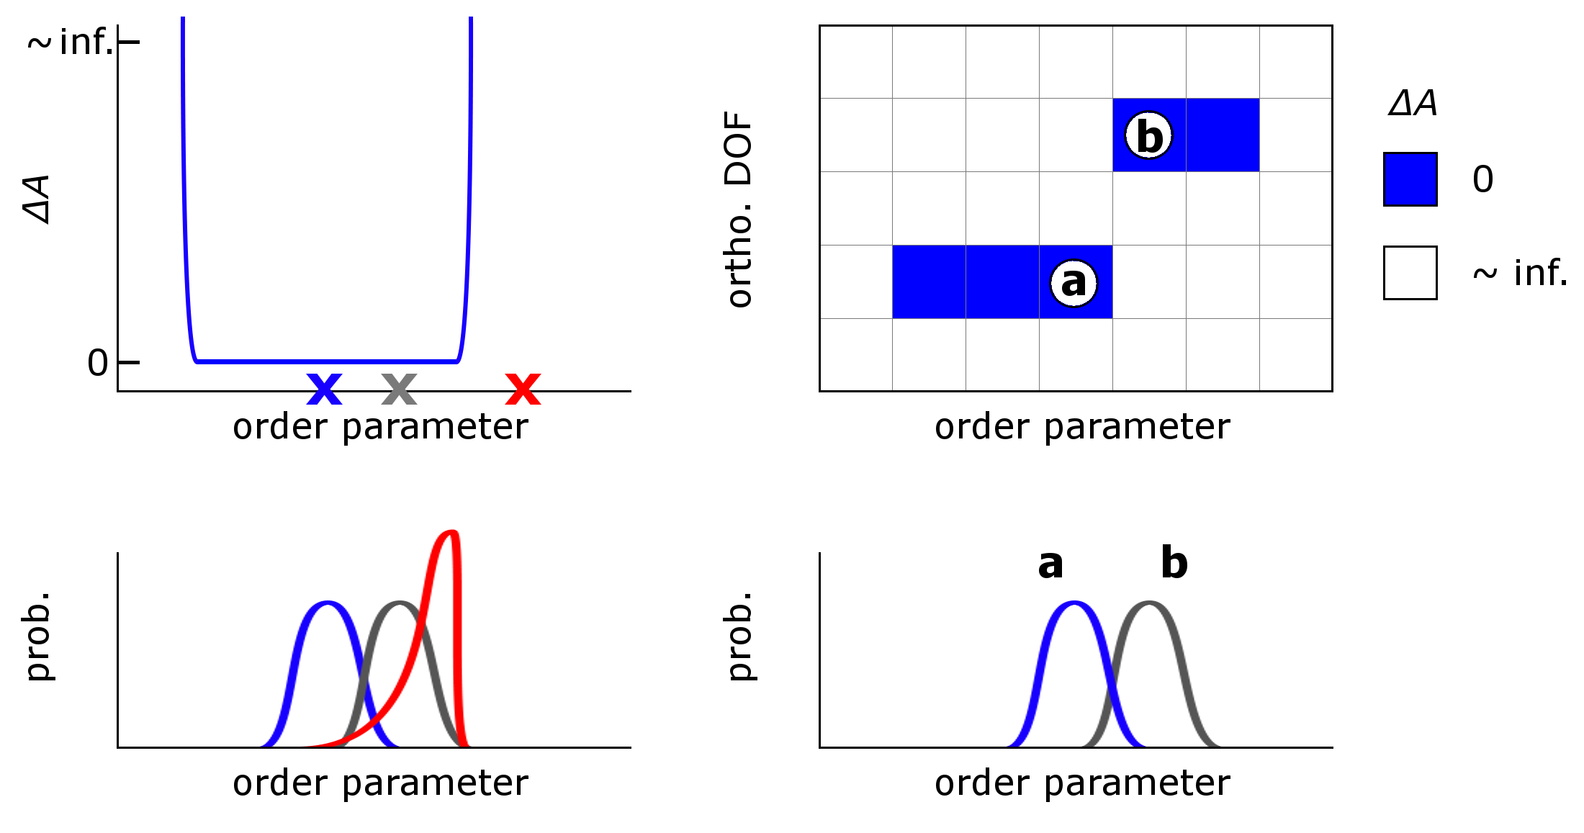
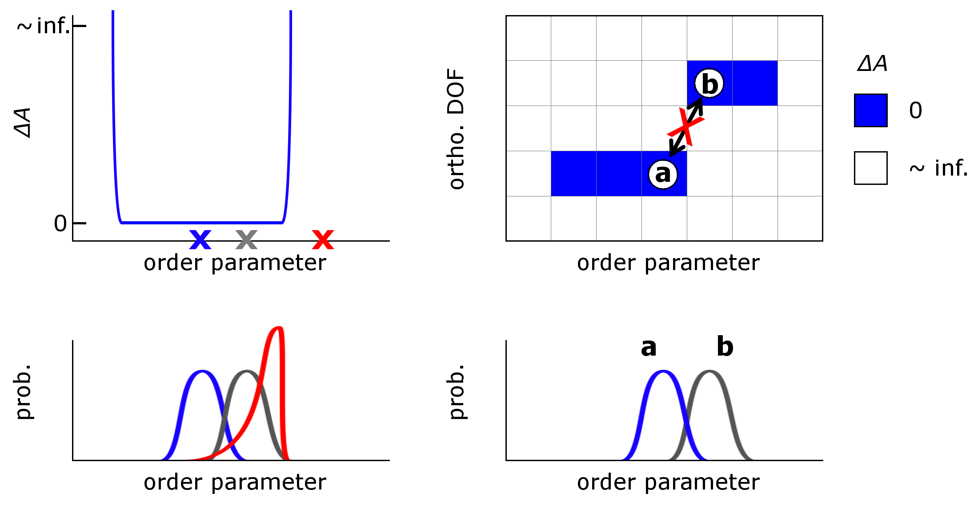
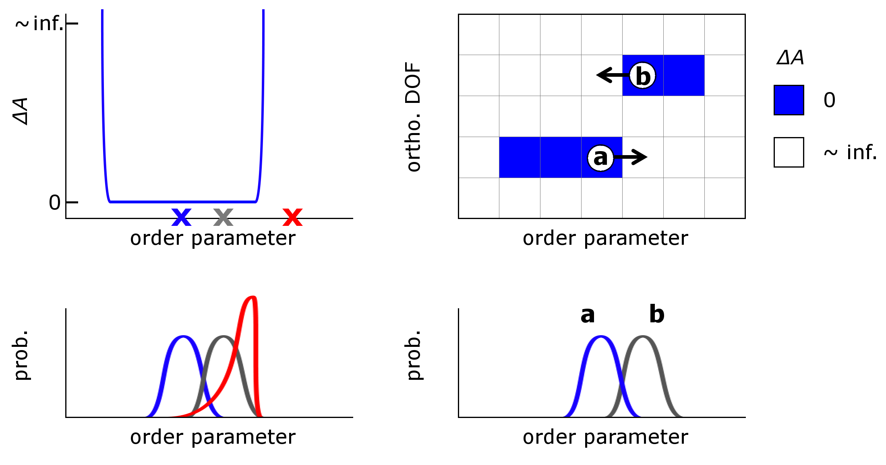
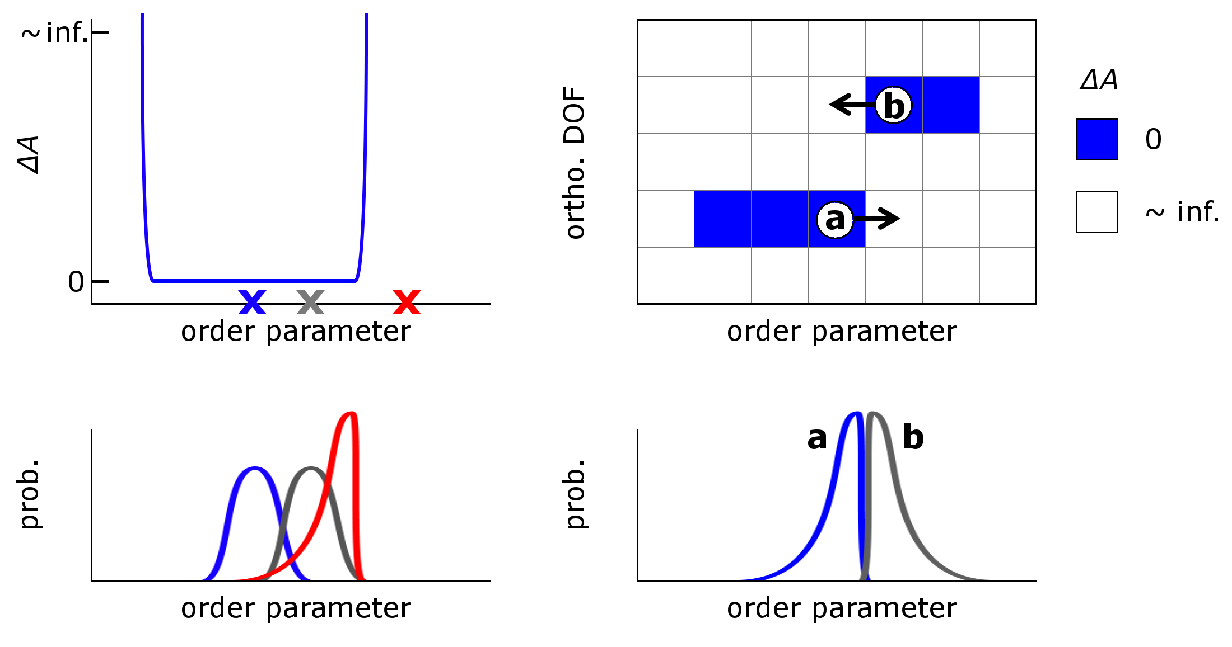
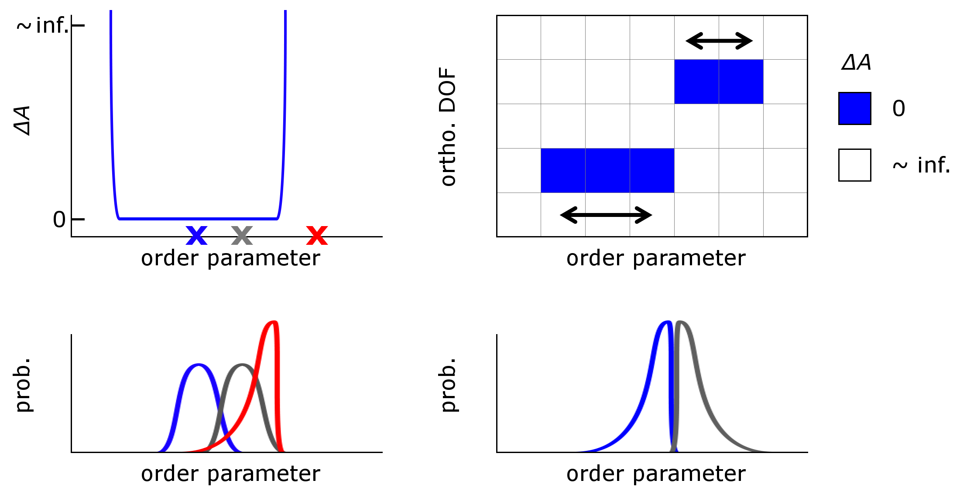
The random walk contains information about hidden barriers

Slide 11
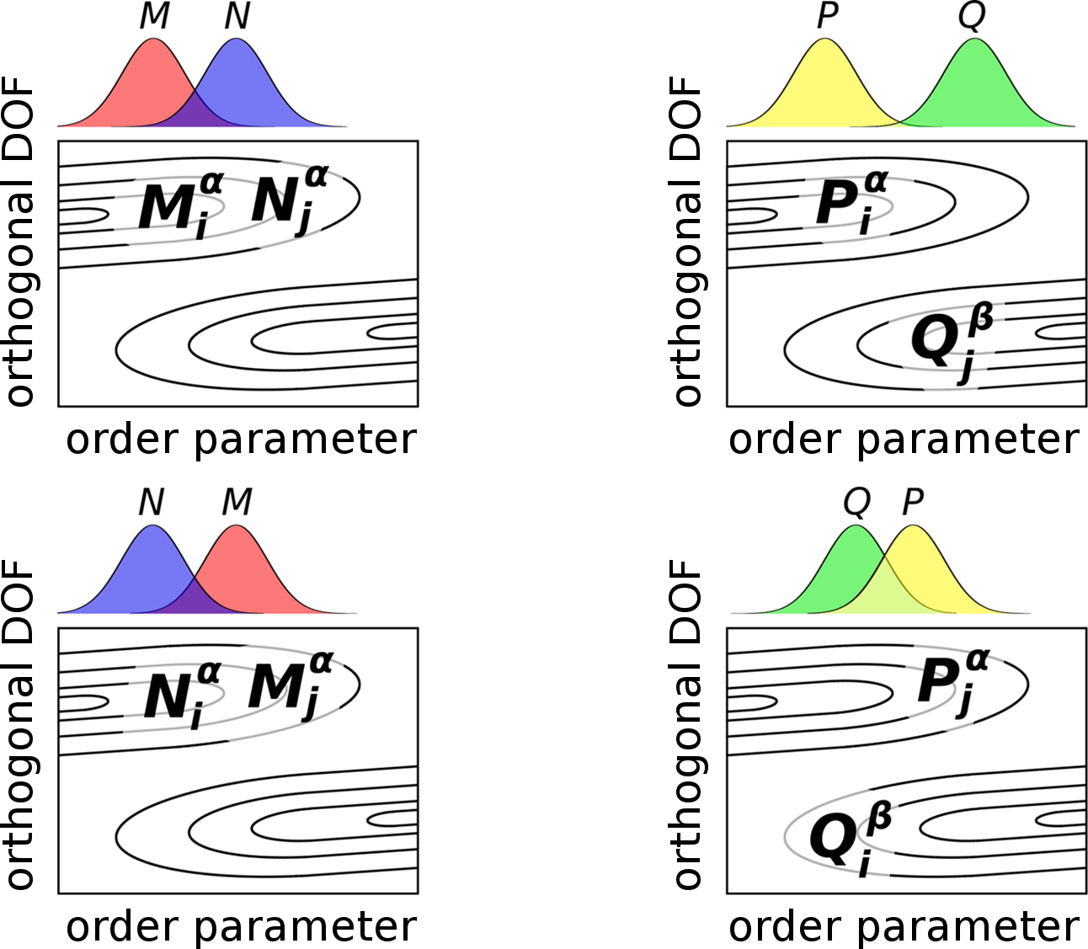

Slide 12
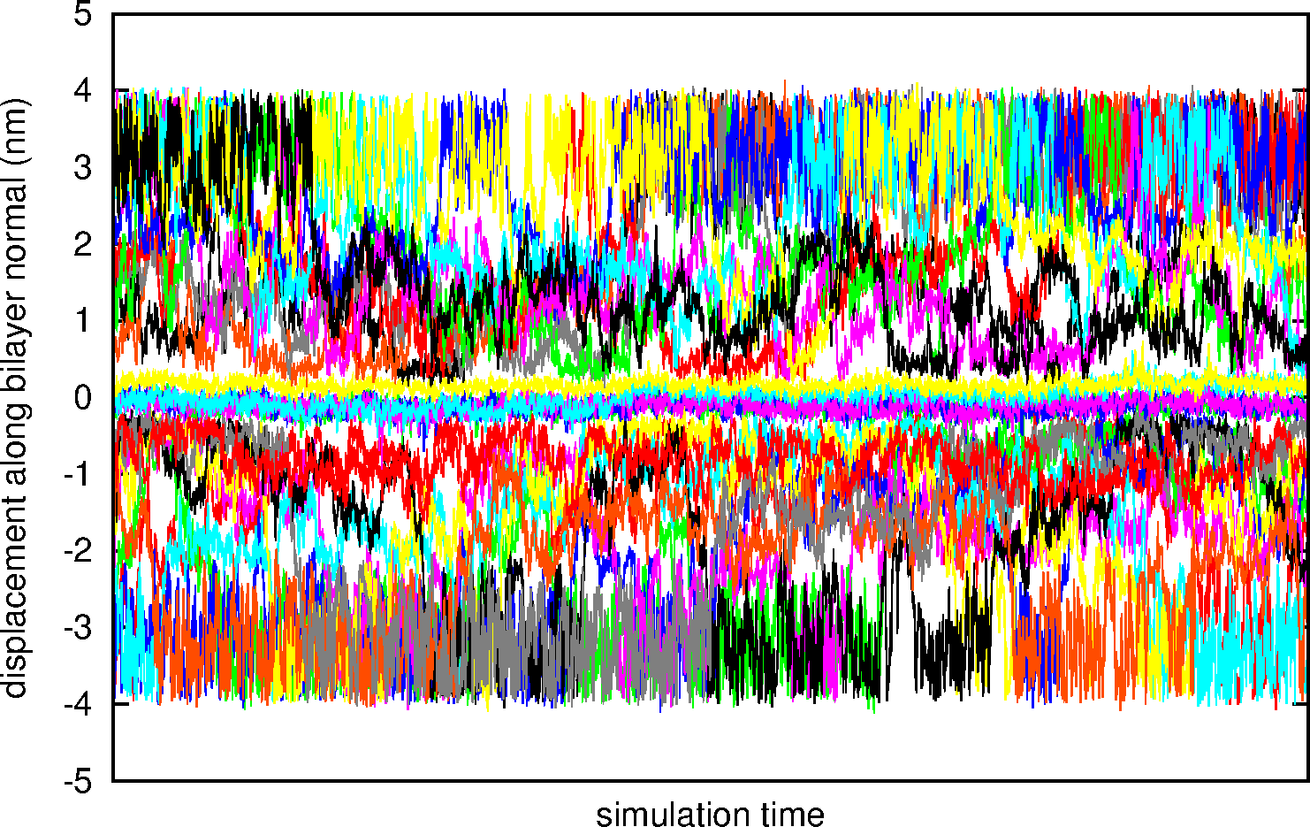
Replica mobility
arginine
One line for each replica
water
Bilayer
(upper leaflet)
Bilayer
(lower leaflet)
water

Slide 13
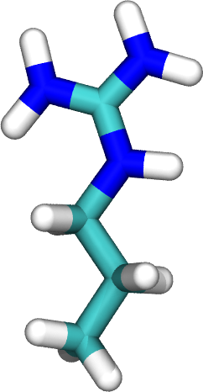
The transmission factor, T, as a measure of local replica diffusion
incident
transmitted
reflected

Slide 14
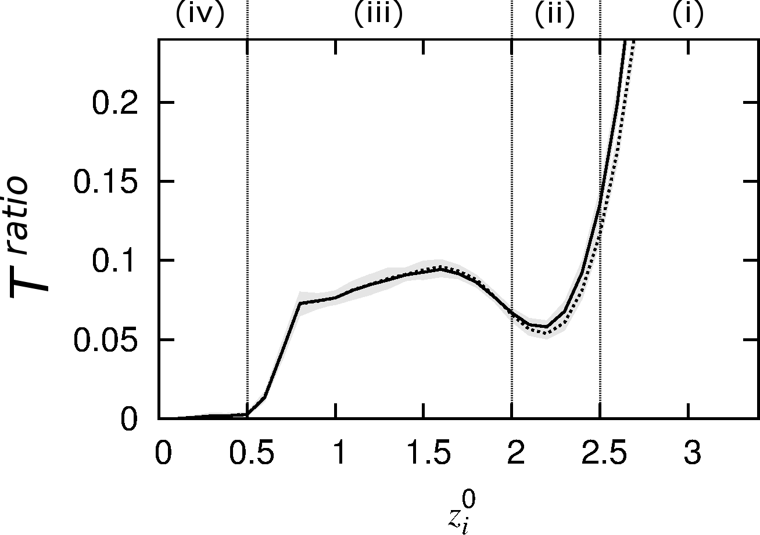
Bilayer
center
water
C. Neale, C. Madill, S. Rauscher, R. Pomès, J. Chem. Theory Comput., 2013, 9(8):3686-3703

Slide 15
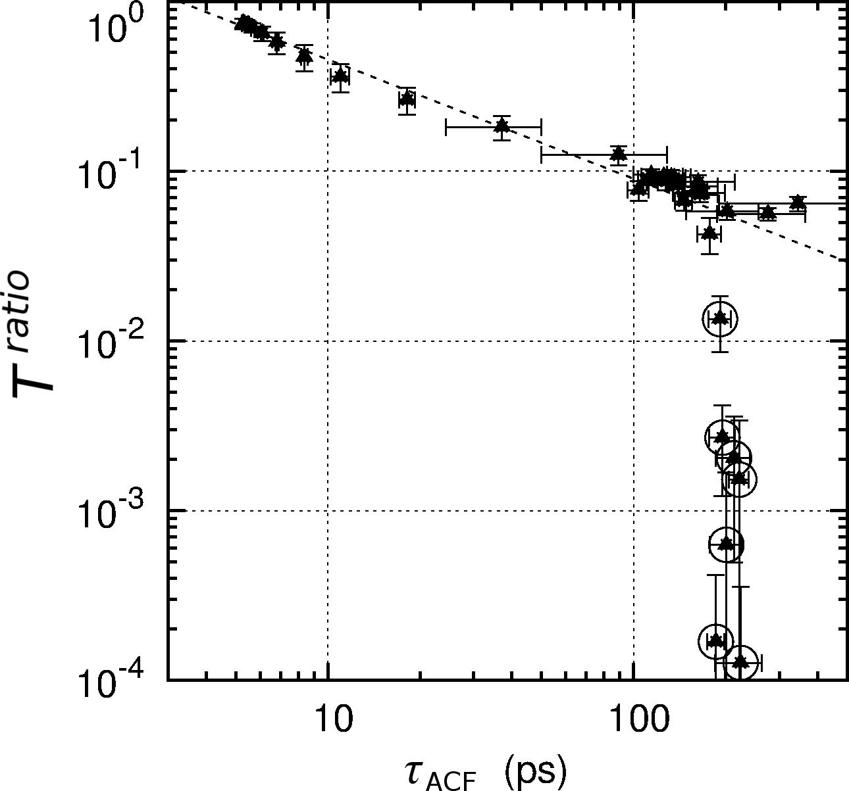
correlates with

Slide 16
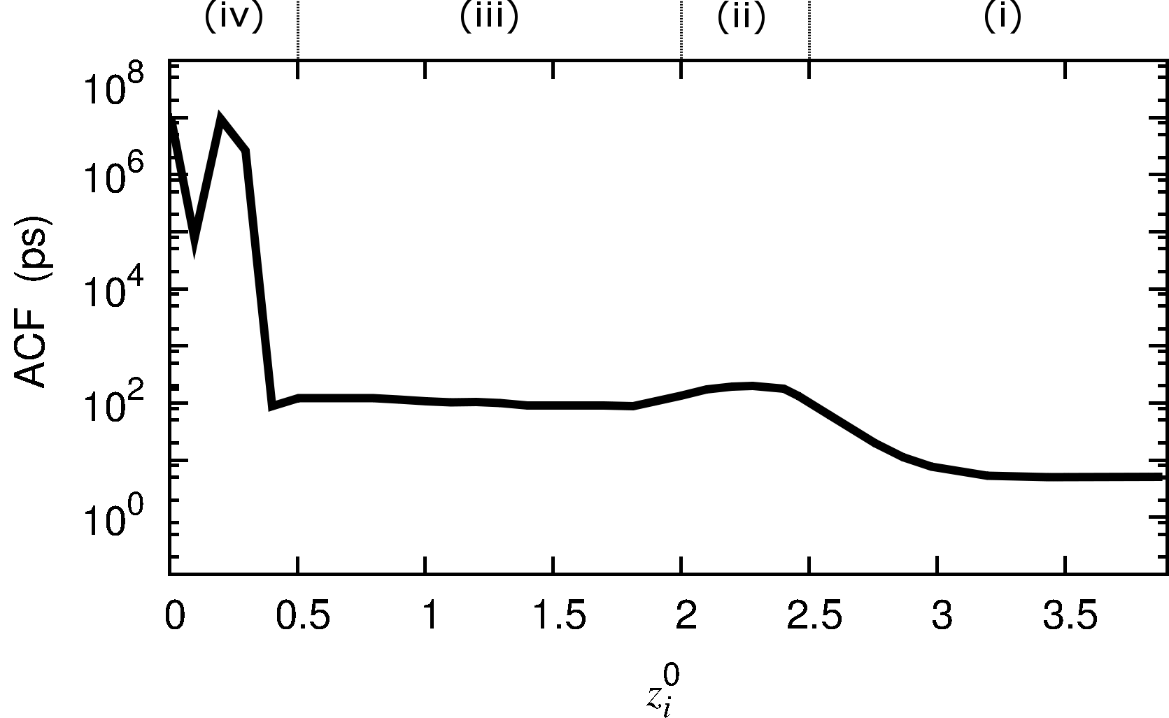
predicts

Slide 17
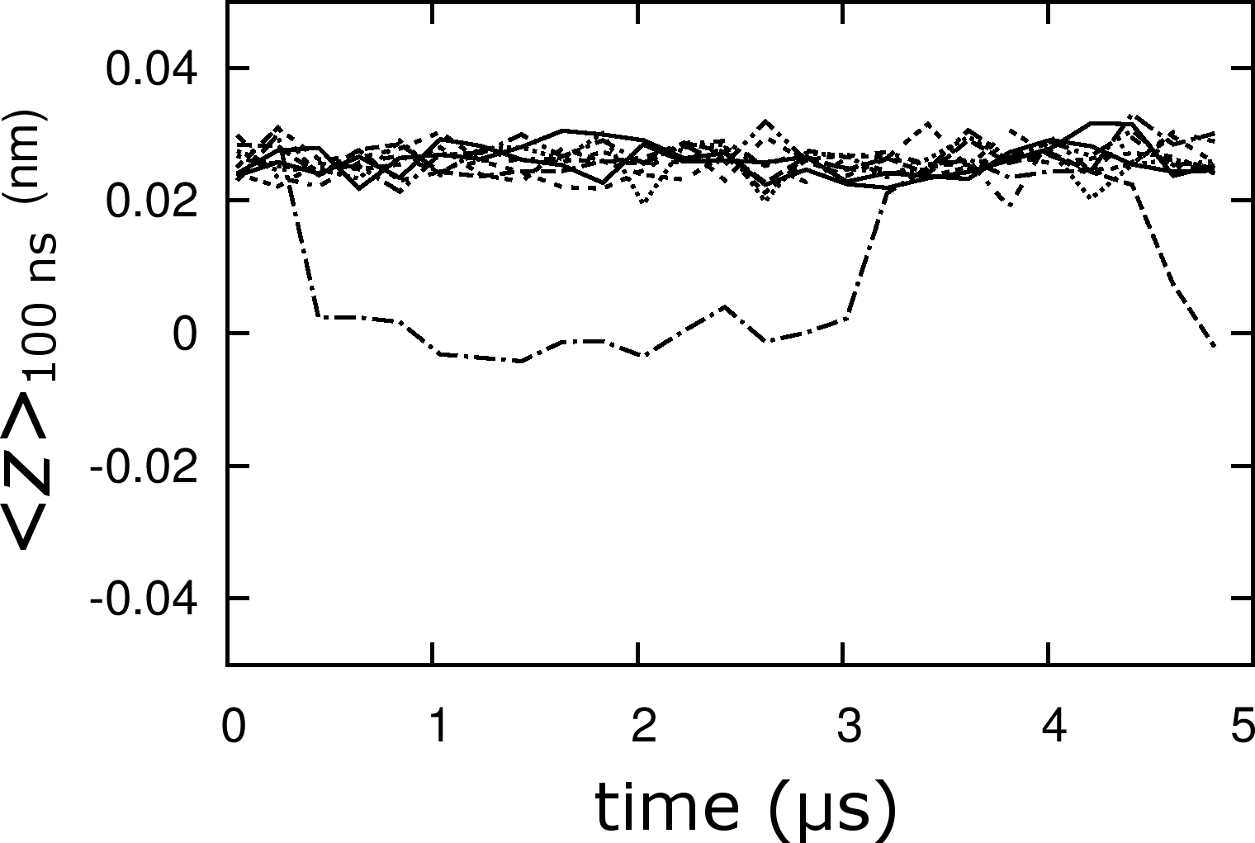
Testing the prediction: 10 x 5-μs restrained simulations

Slide 18
Summary
Long convergence times related to bilayer reorganization
Replica exchange of umbrellas enhances convergence
The transmission factor identifies regions of the order parameter that are prone to systematic sampling errors

Slide 19
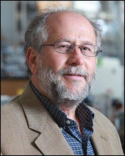
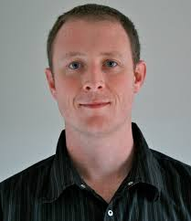
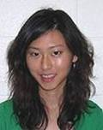
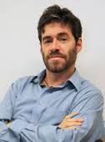
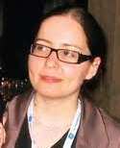
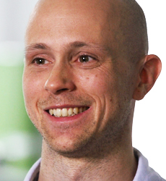
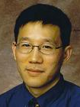
Supervisors:
Collaborators:
Angel García
Drew Bennett
Jenny Hsu
Loan Huynh
Chris Madill
Régis Pomès
Sarah Rauscher
Tom Rodinger
Peter Tieleman
Chris Yip

